Slide 1
ESG & I&D at the heart of everything we do
The Procurement commitments
Global Procurement team
2024

Slide 2
2030 Goals
Where is Kantar on its ESG journey?

Slide 3
“
It is vital that businesses play a part in helping
address the challenges society faces today,
whether social or environmental. We have a role
to play, both in how we operate as a business,
and in the network effect we can have as a
strategic adviser to the largest consumer-facing
companies around the world.
”
Chris Jansen Chief Executive

Slide 4
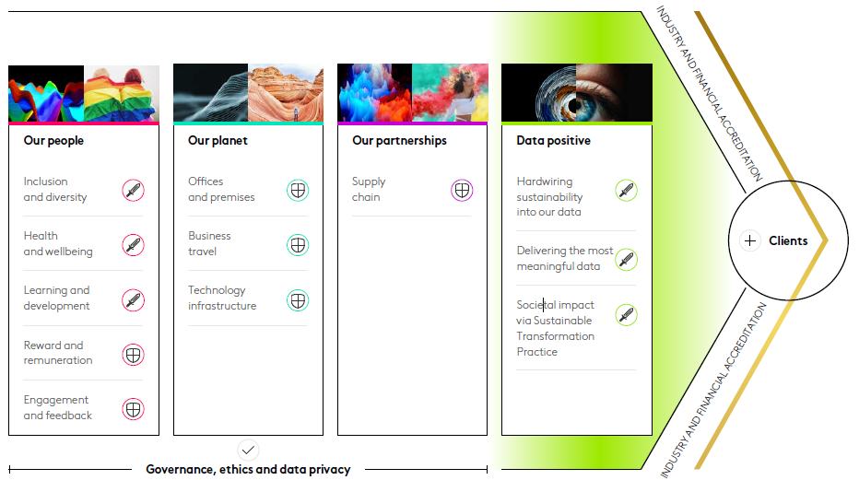
Our Environmental, Social & Governance Strategy
Our ESG strategy sits alongside our purpose and our business strategy in shaping who we are and how we operate as a business.
We aim to make a positive, long-term contribution to the communities where we live and work and use our expertise to have a positive network effect with our clients.
There are lots of issues to consider, but we concentrate on those most relevant and critical to our business. Click here to access our latest ESG report.

Slide 5
Our commitments until 2030
It’s vital that businesses play a part in helping address the challenges society faces today, whether social or environmental.
Our People
Women will represent 50% of our Senior Management population (Global) by 2028
Ethnic minorities will represent 20% of our new joiners into our Senior Management population(US) by 2024
No difference in performance in the belonging question of KES across genders* and ethnicities** by 2024
KES results for I&D-related questions to meet the High-Performance Norm (HPN). (Global) by 2024
Our Planet
We will halve our entire estate’s carbon footprint in our top 40 markets by the end of 2030
Our business travel will be carbon neutral through reduction and Offsetting by the end of 2023
Our strategic data centers will be powered by 85% renewable energy by the end of 2025
Our Partnerships
12% spend with diversely owned suppliers across Coupa markets by 2025
Evaluate top 15 strategic suppliers on their policies and commitments relating to social issues by 2025
Data Positive
Offer all clients sustainability segmentation ‘golden questions’ across primary panels by the end of 2023
Maintain an industry-leading position for CSAT scores on the metric of ‘Quality of Work’
Launch a foundational sustainability training for all employees by the end of 2023
Will have worked with 100% of our global clients on a sustainability Project by 2025

Slide 6
Inclusion & Diversity at the heart of what we do
Procurement Goals
6

Slide 7
What have we done so far?
I&D is a TEAM objective, embedded within our performance review targets
9.03%
Increase spend share with diverse suppliers
$46.816MM
Total Spend with diverse suppliers

Slide 8
12%
target of
Diverse Supplier
spend
Inclusion & Diversity can’t be achieved alone – we need to work in partnership. To achieve our 12% target of diverse supplier spend.*
*by 2025 across all markets on our Coupa S2P system

Slide 9
Inclusion & Diversity can’t be achieved alone!
We need to work in partnership
WE Connect International
We’ve partnered with WE Connect International to provide Kantar access to their global database of 17,000 female owned enterprises.
We continue to develop and leverage a diverse and inclusive global supply chain.
Supplier IO
Identifying and accrediting diverse ownership in NAM and UK&IR.
We want to spend smarter, buy more responsibly and measure more effectively.
Promoting I&D in our Workplace!
In collaboration with &Sisters, we’ve introduced free, sustainable female hygiene products at our new London and Porto Offices.
Additionally, we have gender balanced interview panels on all recruitment screening.
INTERN23 initiative
Kantar is proud to present INTERN 23, an impactful initiative aimed to provide a different experience for 25 students from underprivileged backgrounds, offering them the opportunity to get to know what it’s like to work in an office environment.

Slide 10
What we’ve done so far…
As part of our commitment of driving I&D, Kantar has partnered up with Merit Incentives as our preferred global supplier
By leveraging our customer and employee engagement strategies on Merit Incentives, we can focus on what really matters – our vision and growth.
We partnered up with Merit incentives, a company that’s supporting over 1,000+ large companies and fast-growing businesses to increase engagement levels with their stakeholders by using their smart technologies combined with a global Partner Merchant Network.
With Julie Leblan, founder and CEO of Merit Incentives, one of the 20 Women Behind Middle Eastern Tech Brands and cofounder and member of the Women in Incentives Network.

Slide 11
Inclusion & Diversity and ESG at the heart of everything we do
To contact the ESG team, please click here.
E-Mail: procurement@kantar.com
Kantar I&D website
Supplier Hub
Kantar Group and Affiliates
Vivo Building
30 Stamford Street
London SE1 9LQ

Slide 12
ESG & I&D at the heart of everything we do
The Procurement commitments
Global Procurement team

